Slide 1
Reducing downtime and Enhancing Production Efficiency at ABC Oil Extraction Facility

Slide 2
Define Phase
Deliverables
Capturing VOC
Translating VOC to CTQ
Process Mapping
Project Charter

Slide 3
Case – (Oil production rate)
In the quarter-Q1 (3 months- Apr-Jun), the oil extraction operations at ABC facility have experienced an average downtime of 15%, which is 5% higher than the industry benchmark of 10%. This increase in downtime is primarily due to frequent equipment failures, delays in maintenance, and inefficiencies in the extraction process. As a result, the facility has suffered from reduced oil production rates, increased operational costs, and a negative impact on overall profitability.
The 15% downtime has led to a 20% reduction in daily oil production, affecting the facility’s ability to meet its production targets and supply commitments.
Increased downtime has resulted in additional maintenance costs and lost production revenue, totaling an estimated $5 million over the past six months.
Inconsistent production rates and delays in supply can negatively impact customer satisfaction and damage long-term relationships with clients.
Six Sigma team entrusted with the task of studying the problem in greater detail from all the stakeholders prospective and present to the management the following
Voice of the Customer (VOC) : Scientifically Analyzed
Critical to Quality Characteristics (Customer as well as Orange)
A High Level Process Map.
A detailed planning document. (Project Charter)

Slide 4
Define
Capturing Voice of Customer
Customer | Voice (in his own words)
Customer | Timely deliveries and adhere to agreed-upon supply commitments.
 | Reliable and consistent production levels to meet market demands and supply commitments without interruptions.
 | Defect free product
 | Affordable pricing structure
 | Need clear and timely communication regarding project status, potential issues, and updates

Slide 5
Define
Identifying CTQs
Customer | VOC (in his own words) | CTQs
Customer | Timely deliveries and adhere to agreed-upon supply commitments. | Ontime delivery
 | Reliable and consistent production levels to meet market demands and supply commitments without interruptions. | Efficiency
 | Defect free product | First time acceptance
 | Affordable pricing structure | Billing per hour
 | Need clear and timely communication regarding project status, potential issues, and updates | Customer feedback score
Which Customer will be the primary focus for this project?
Customer.
Which CTQ(s) will be the primary focus for this project?
Ontime delivery
Efficiency
First time acceptance
Billing per hour
Customer feedback score

Slide 6
Define
High Level Process Map
S
I
P
O
C
Supplier
Input
Process
Output
Customer
Set up the equipment
1
Equipment Vendor
Extraction equipment
Extracted Oil
2
Operation
Production reports
3
Monitoring
Raw material supplier
Raw materials- Chemicals
Maintenance
Customer
4
Operational data
5
Troubleshooting
Maintenance service provider
Cost reports
Workforce
6
Production
7
Reporting

Slide 7
Customer Satisfaction
Define
Project Charter
Business Case: The ABC facility has experienced an average downtime of 15% over the past six months, significantly higher than the industry benchmark of 10%. The consequences include a 20% reduction in daily oil production, higher operational costs, and an estimated $5 million in lost production revenue. This situation is also negatively impacting customer satisfaction and damaging long-term client relationships.
Scope
In Scope: Downtime reduction, production efficiency improvement, cost management
Out Scope: Facility expansion, non-extraction processes, long-term strategic changes.
Goals & Objectives: 1.Achieve a reduction in average downtime from 15% to 10% within the next six months to align with industry standards.
2. Increase Production Efficiency: Improve daily oil production rates by 20% to meet production targets and supply commitments.3. Decrease maintenance and lost production costs by $3 million over the next six months.
Any Constraints/Challenges:
Resource Availability
Timelines
Budget
Problem Statement: The oil extraction operations at ABC facility are suffering from excessive downtime (15%), which is 5% above the industry standard. This downtime is causing:
Reduced Production Rates: A 20% decrease in daily oil production.
Increased Operational Costs: Additional maintenance costs and revenue losses totaling approximately $5 million in the last six months.
Customer Impact: Delays and inconsistent production are leading to decreased customer satisfaction and potential damage to long-term client relationships.
Team:
Sponsor: GM Rao
Six Sigma BB consultant: Uma
Team: Customer service staff , Operation team , maintenance team.
Benefits:
Cost Savings
Increased Revenue
Improved Customer satisfaction & Reputation
Milestones
Define phase: 1 Week- 10th Aug’24
Measure phase: 2 Weeks – 24th Aug’24
Analyze phase: 2 weeks- 8th Sep’24
Improve phase: 3 weeks- 28th Sep’24
Control phase: 2 weeks- 10th Oct’24

Slide 8
Measure Phase
Deliverables
Performance Variable (CTQ)
Data Planning
MSA
Stability & Capability Analysis

Slide 9
Measure
Establishing Performance Variable (CTQ)
Performance Variables or CTQ Characteristics
Sl. No | Performance Variable (CTQ Characteristics) | Variable Type Measurable or Attribute | Specifications |  |  | Remarks (If Any)
 |  |  | Target | LSL | USL
1 | Ontime delivery | Attribute | 99% | 98% | 100% | OTD= [Delivered count/Planned count] *100%
2 | Efficiency | Continuous | 99% | 95% | 100% | Efficiency=[Actual output in bbls/Targeted output in bbls]*100%
3 | First time acceptance | Attribute | 98% | 95% | 100% | FTA=[First time right product/Total number of products]*100%
4 | Billing per hour | Continuous | 6$ per hour | 4$ | 7$ | Total billing amount/Total worked hours
5 | Customer feedback score | Attribute | 7 | 6 | 7 | 1 to 7 scale

Slide 10
Measure
Establishing Performance Standards
Y
Efficiency
Continuous
Project Tool tracker for the Oil extracted in bbls
LSL-95%
Y
Specifications
Target-99%
USL-100%

Slide 11
Measure
Data Collection Plan
Sl.No | Performance Variable | Type (Continuous/ Attribute) | Specs | Measuring Instrument | Data Collection Plan | Remarks (if any)
1 | Ontime delivery | Attribute | 99%+-1 | Project tracker. | Monthly, deliverables
2 | Efficiency | Continuous | 99%+1, -4 |  | Monthly, Production reports
3 | First time acceptance | Attribute | 98%+2, -4 |  | Monthly, Quality feedback reports
4 | Billing per hour | Continuous | 6$ per hour |  | Monthly, Invoice reports
5 | Customer feedback score | Attribute | 7-1 |  | Monthly ,Customer feedback form
Source/Precautions/Constraints
Project dashboard – time spent details and efforts accounting.

Slide 12
Measure
Performance Evaluation
(Stability Analysis)
Sl.No | Performance Variable (CTQ) | Type (C/D) | Stability Diagnostics
 |  |  | Test Method | Result | Action & verification (In case of unstable process)
1 | Ontime delivery | Discrete | Box plot, Histogram | Unstable | Removed outlier at less & high deliverable count and stabilized the data.
2 | Efficiency | Continuous | IMR chart , Box plot | Unstable | Removed outliers at high barrels.
3 | First time acceptance | Discrete | Box plot, Histogram | Unstable | Removed outliers
4 | Customer feedback score | Discrete | Box Plot, Histogram | Stabled

Slide 13
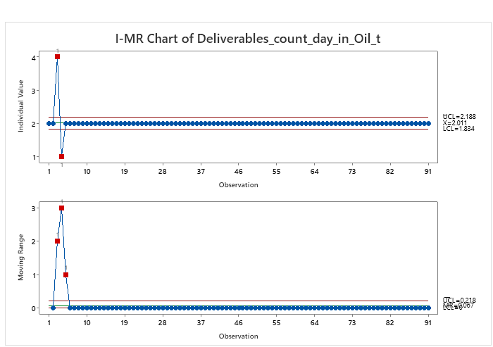
Measure
Performance Evaluation
(Stability Analysis)
On Time Delivery
X-bar (mean) = 2.011, which represents the average value of deliverables per day in the process.
Control Limits:
Upper Control Limit (UCL) = 2.188
Lower Control Limit (LCL) = 1.834
All points except for 2 points at the beginning are exceeding the control limits (marked in red squares might be due to special cause), which indicates out-of-control points for the individual values early in the process.
However, after that, the process seems stable and well-controlled.
After the initial phase, the process stabilizes, with both the individual and moving range charts indicating control.

Slide 14
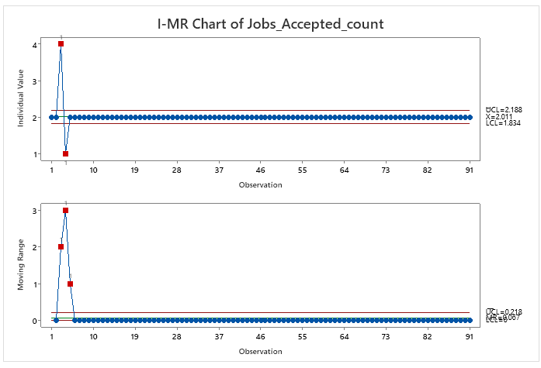
Measure
Performance Evaluation
(Stability Analysis)
Right time First
X-bar (mean) = 2.011, which represents the average number of jobs accepted in the process.
Control Limits:
Upper Control Limit (UCL) = 2.188
Lower Control Limit (LCL) = 1.834
There are 2l out-of-control points in the early part of the process, marked in red squares.
These points fall outside the control limits, indicating abnormal variations early on. Afterward, the individual data points are tightly centered around the mean, indicating stability and control.
After the initial phase, the process stabilizes, with both the individual and moving range charts indicating control

Slide 15
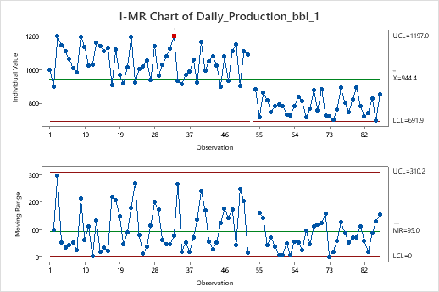
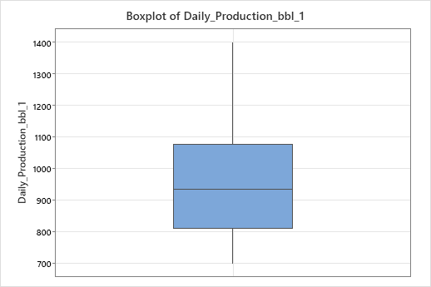
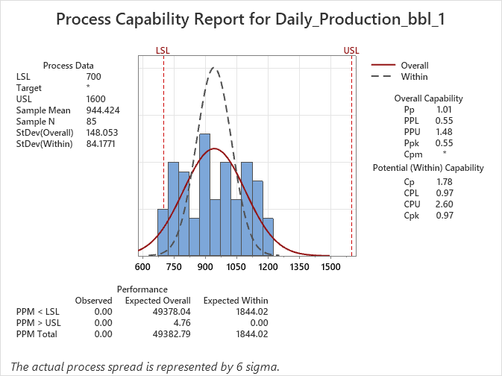
Measure
Performance Evaluation
(Stability Analysis)
Efficiency:
Cp (Pp) is 1.01 and Cpk (Ppk) -0.55
Cp of 1.01 indicates that the overall process spread (based on 6 sigma) is slightly wider than the specification limits.
Cpk of -0.55 This represents the overall process capability, taking both LSL and USL into account. A value < 1 implies that the process may not consistently produce within specifications..

Slide 16
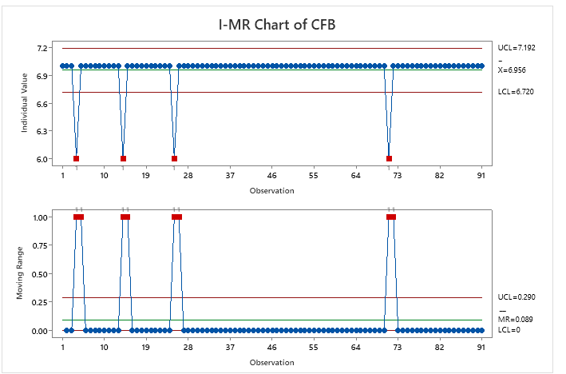
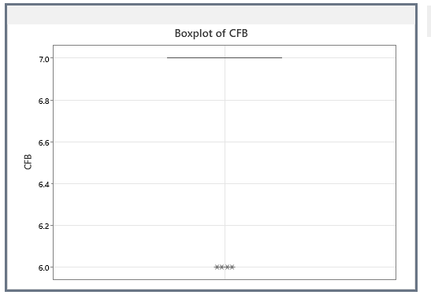
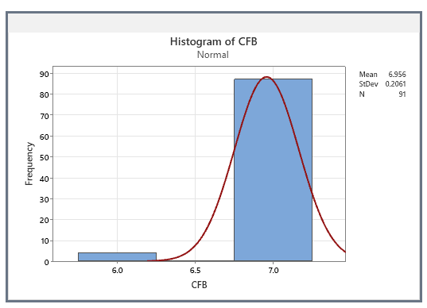
Measure
Performance Evaluation
(Stability Analysis)
Customer Feedback:
IMR_ Inference:
X-bar (mean) = 6.956, which represents the average customer feedback score across the process.
Control Limits:
Upper Control Limit (UCL) = 7.192
Lower Control Limit (LCL) = 6.720
Few of the ratings received less than lower limit 6.72 which are “6” , action plan required to be taken on the low scores.

Slide 17
Measure
Performance Evaluation
(Capability Analysis)
Equipment downtime
Delay in maintenance hours
LSL-95%
Tolerance
Target-99%
USL-100%
Y
Mean- 944.42
Descriptive Statistics
Efficiency- Daily production_bbl
SD-148.05
Cp-1.01
Performance Metrics
Cpk-0.55
Sigma Level-3.75
DPMO-606400

Slide 18
Analyze Phase
Deliverables
Establishing Gap (Benchmarking)
Detailed Process Analysis (Potential Causes
Identifying Root Causes
Validating Root Causes

Slide 19
Analyze
Establish Performance Gap
(Benchmarking)
Sl.No | Performance Variable (CTQ) | Baseline Performance | Benchmark Performance | Remarks
1. | Ontime delivery | 99% | 99% | Deliveries shipped as agreed with the customer.
2. | Efficiency | 95% | 99% | The targeted daily oil barrels yield is not met.
3. | First time acceptance | 98% | 98% | Quality of the oil delivered is meeting the defined specifications.
4. | Customer feedback score | 6.9 | 7 | Customer feedback is slightly less than the target 7.0

Slide 20
Analyze
Detailed Process Analysis
Detailed Process flow mapping
Equipment (Rig) Supplier
Site Preparation
Drilling the Well
Casing Installation
Cementing
Wellhead Installation
Perforation
Completion
Pumping Oil
Separation of Oil, Gas, and Water
Dehydration and Desalting
Storing oil in tanks
Customer
Waiting time

Slide 21
Analyze
Detailed Process Analysis
 | Oil Extraction Process | Current State_ Class A type well |  |  |  | Current State class B type well
Activity No. | Activity Description | Cycle Time ( hrs) | Waiting time ( in hrs) | Lead Time | Remarks | Cycle Time ( hrs) | Waiting time ( in hrs) | Lead Time | Remarks
Activity 01 | Clear the location and set up the drilling rig. | 70 | 0 | 70 |  | 68 | 0 | 68
Activity 02 | Drilling rig bores through the earth’s crust to reach the oil reservoir, using a drill bit connected to a long string of drill pipes. | 70 | 0 | 70 |  | 72 | 0 | 72
Activity 03 | Casing pipes are inserted into the drilled hole to stabilize the well, prevent collapse, and isolate the oil-bearing zone from other layers. | 70 | 0 | 70 |  | 70 | 0 | 70
Activity 04 | Cement is pumped between the casing and the wellbore to secure the casing in place and prevent fluid migration. | 80 | 0 | 80 |  | 81 | 0 | 81
Activity 05 | A wellhead is installed at the top of the well to control pressure, flow, and provide access to the reservoir. | 70 | 0 | 70 |  | 69 | 0 | 69
Activity 06 | Perforating gun is lowered into the well and fired to create small holes in the casing and cement, so that holes allow oil to flow from the reservoir into the well. | 25 | 0 | 25 |  | 22 | 0 | 22
Activity 07 | Install tubing, packers (to isolate zones), and other equipment inside the well. | 20 | 0 | 20 |  | 18 | 0 | 18
Activity 08 | Pumps are used to bring oil to the surface when the natural pressure isn't enough. | 24 | 4 | 28 | Pump failure | 24 | 5 | 29 | Pump failure
Activity 09 | Oils mixture consists of gas and water which is brought to the surface, it is directed into a separator. | 24 | 0 | 24 |  | 24 | 0 | 24
Activity 10 | Oil passes through electrostatic or thermal dehydrators, where any residual water is removed. | 6 | 0 | 6 |  | 5 | 0 | 5
Activity 11 | The oil is then passed through desalters to remove salts that could cause corrosion in pipelines or refineries | 6 | 0 | 6 |  | 6 | 0 | 6
Activity 12 | Crude oil is stored in large storage tanks to await transportation. Oil is monitored to prevent overflow, and tanks are equipped with pressure control systems. | 24 | 0 | 24 |  | 24 | 0 | 24
Time Study | Current State_ Class A Well | Current State_ Class B Well
Total Cycle time in hours | 489 | 483
Total Lead time in hours | 493 | 488

Slide 22
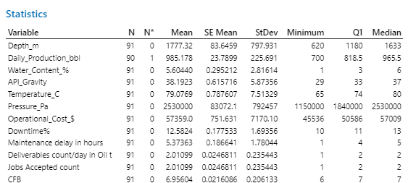
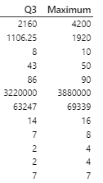
Analyze
Detailed Process Analysis
Inference from descriptive statistics:
Mean of downtime% is 12.584% against the Organization benchmark target of 10%. This is impacting the daily oil production _ bbl whose mean value is 985.178 bbls against the target 1200 bbls/ day.

Slide 23
Analyze
Potential Variation Sources
(Root Causes)
Equipment
Human
P
Equipment
E
Environment
E
Inadequate training
Lack of expertise
Delayed response
Worn-out components
Inadequate maintenance
Power supply issues
Incorrect sizing
Corrosive well conditions
Extreme temperatures
Sand and debris in oil
Vibrations from nearby equipment
Low
Efficiency
1. Improper installation
2. Lack of monitoring systems
3. Suboptimal procedures
4. Incorrect operation
Poor maintenance scheduling
Budget constraints
No spare parts availability
Low-quality components
Contaminants in oil
Inadequate lubrication
Processes
P
Management
M
Materials
M

Slide 24
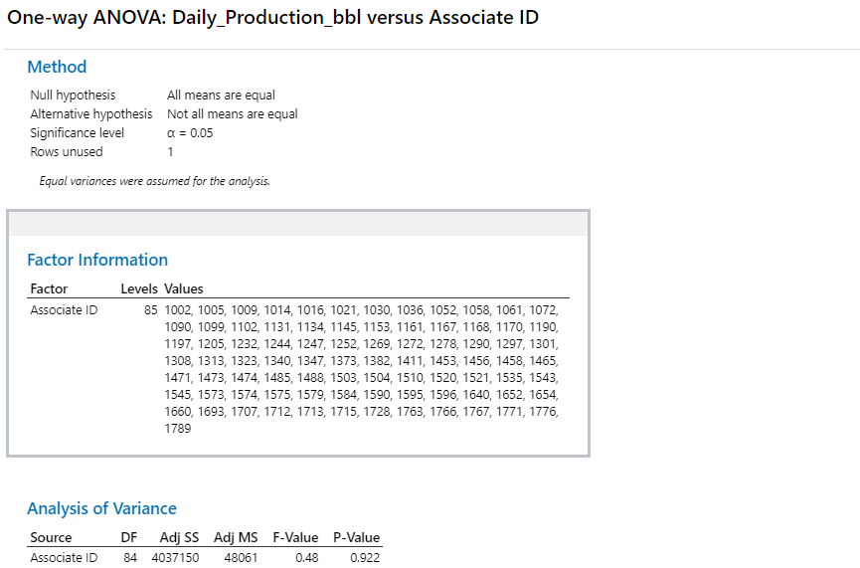
Analyze
Hypothesis Testing on associate competency
Inference:
Performed hypothesis testing (ANOVA) on associate ID with the daily oil production.
P-value is 0.922 > 0.05 states that, failed to reject null hypothesis.
The means of daily oil production achieved is same with respect to associate . So, associate competency not impacting the daily oil production yield.

Slide 25
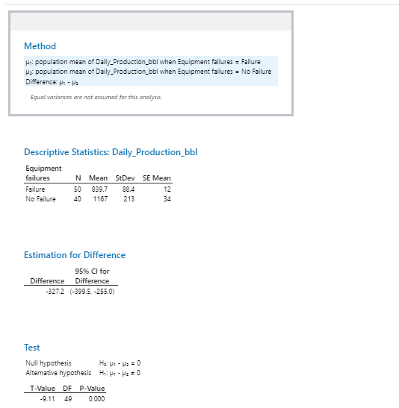
Analyze
Hypothesis Testing on equipment failures
Inference:
Performed hypothesis testing 2-Sample T test on equipment failure and daily oil production.
P-value is 0 < 0.05 states to reject null hypothesis.
The means of daily oil production achieved is not same with respect to equipment failures .
So, whenever there is an equipment failure the daily oil production yield is getting impacted.

Slide 26
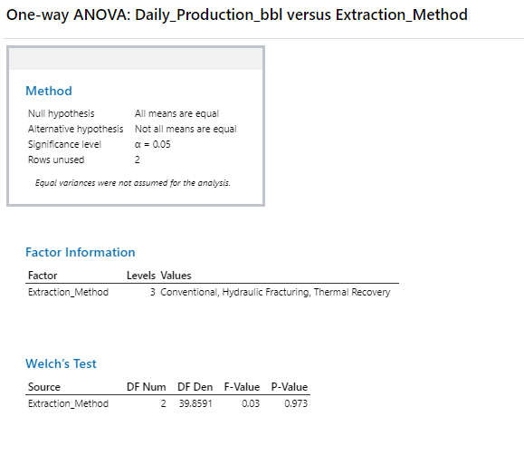
Analyze
Hypothesis Testing on Extraction method
Inference:
Performed hypothesis testing (ANOVA) on extraction method with the daily oil production.
P-value is 0.973 > 0.05 states that, failed to reject null hypothesis.
The means of daily oil production achieved is same with respect to the type of extraction method . So, extraction method is not impacting the daily oil production yield.
.

Slide 27
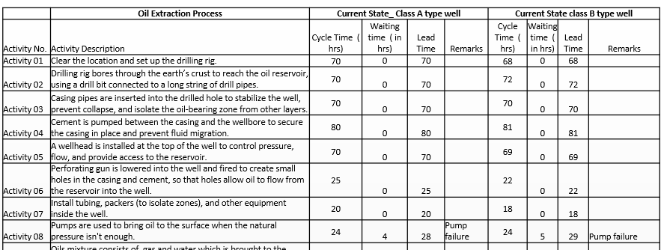
Analyze
Validating the root cause
Based on the investigation of hypothesis testing and value stream mapping performed on well production data below is the summary.
Equipment Failures as the primary Root Cause
Equipment failures in oil production is significantly reducing operational efficiency, disrupt workflows, and ultimately lower the daily oil yield. The nature of oil production involves several critical components, including pumps, compressors, valves, pipelines, and processing units. Failures or malfunctions in these components can directly impact oil extraction and production rates.
Pump Failures (e.g., Electric Submersible Pumps, ESPs): Pump responsible for lifting oil to the surface fails, production stops or slows significantly. Intermittent failures or pump inefficiencies may lead to irregular production flow.
Pump failure resulted waiting time as observed in VSM cycle time study and in 2-Sample t test showed there is a significant difference in means of daily oil production where there is an equipment failure.

Slide 28
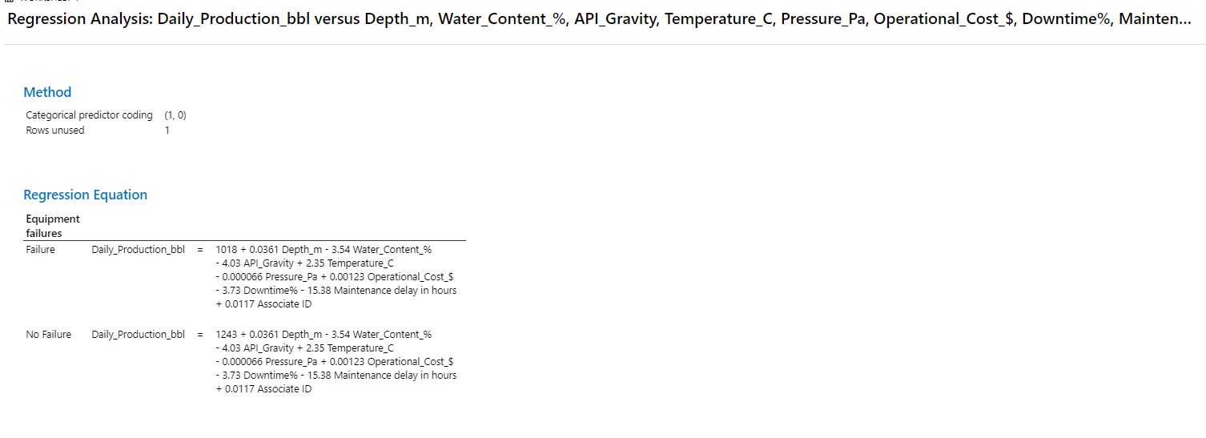
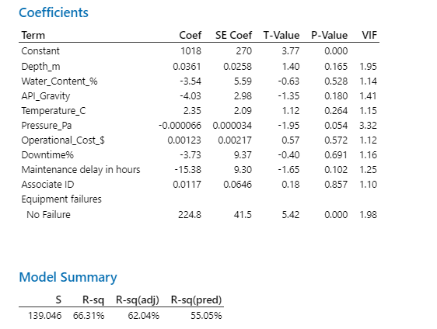
Analyze
Regression Model with all predictors
Inference: An adjusted R² of 62% indicates that the model provides a moderate to strong explanation of the dependent variable based on the included predictors. It can be considered as suitable to predict from the model.

Slide 29
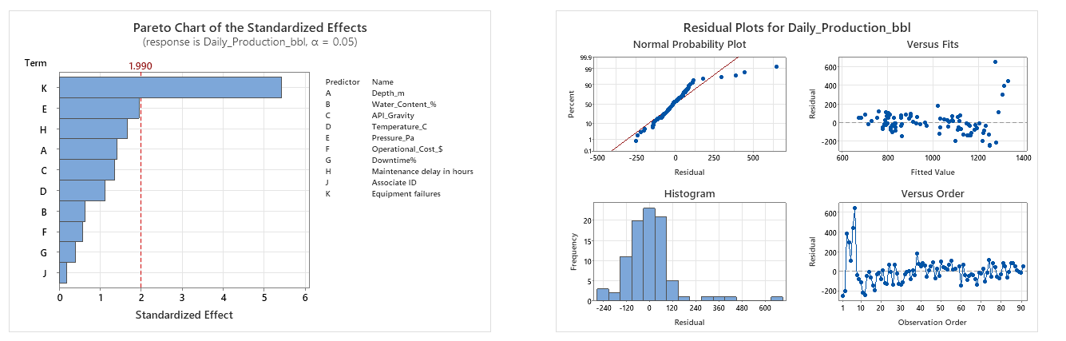
Analyze
Residual plots of daily oil production in bbls
Inference:
The residuals show that the model generally fits well, as they are approximately normally distributed and randomly scattered around zero. Pareto plot shows the major contribution impacting the daily oil production is by the predictor “K” - “ Equipment failures”.

Slide 30
Improve Phase
Deliverables
Discovering Variable Relationships
Developing Potential Solutions
Arriving at the best/optimal solution
Validating/Piloting the optimal solution

Slide 31
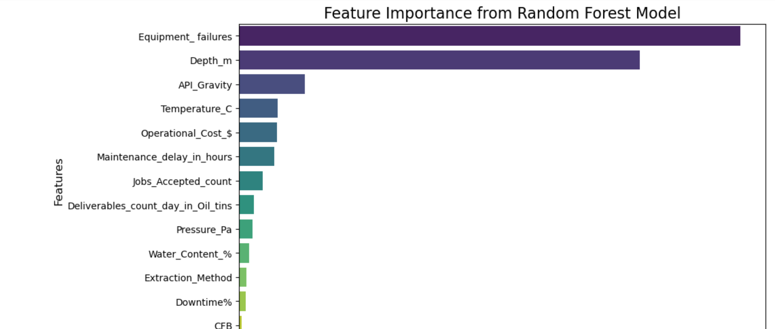
Improve
Modelling of data_ Random Forest model
Performed random forest model on the oil extraction data and plotted feature wise importance.

Slide 32
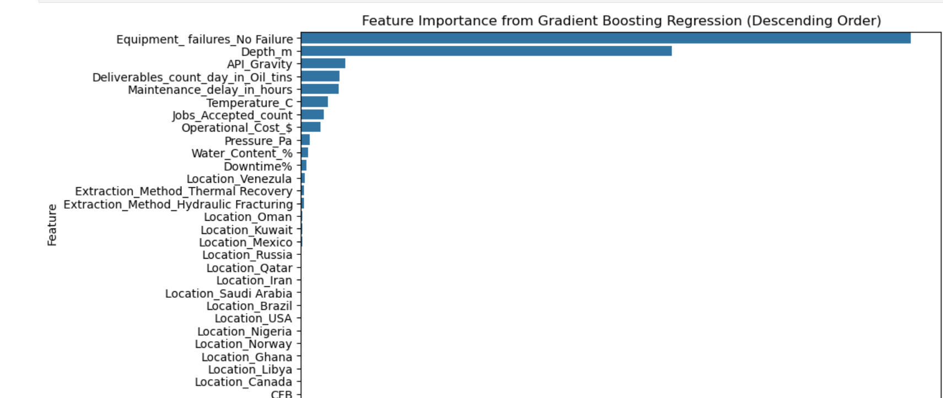
Improve
Modelling of data_ Gradient Boosting model
Performed gradient boosting model on the oil extraction data and plotted feature wise importance.

Slide 33
Improve
Models Inference
Inference from the Random forest and Gradient boosting models
Equipment failures ( Highest Importance): Equipment failures have a significant impact on production. When failures occur, they can halt operations or reduce efficiency, thus leading to lower production. Managing equipment reliability is crucial. Preventing equipment failures is critical to maintaining or improving production levels.
Depth_m (second Importance): Well depth is moderately important. The deeper the well, the more challenging it might be to extract oil, but deeper wells could also access larger reserves, impacting overall production levels. This suggests that the depth at which the drilling or extraction is happening strongly influences production. Optimizing or maintaining the correct depth is essential for maximizing output.
API_Gravity: The third most important variable. API gravity measures the density of the oil. It seems that oil density plays a significant role in determining production efficiency or profitability.

Slide 34
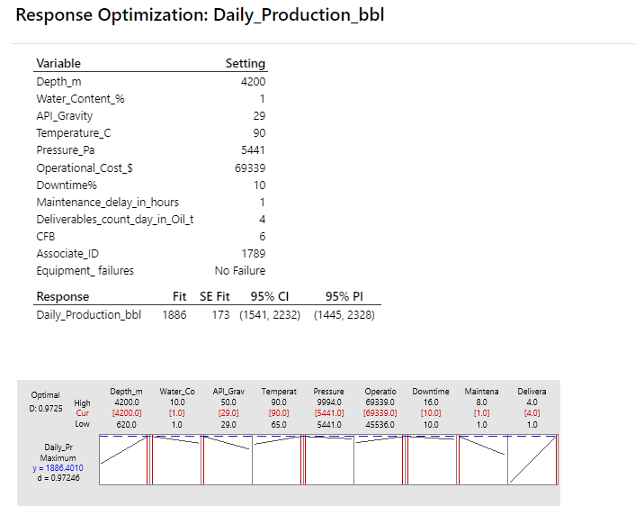
Improve
Develop Optimum Solution
Optimized Response:
The Daily Production (bbl) is optimized at 1886 bbl/day, with a 95% Confidence Interval (CI) ranging from 1541 to 2232 bbl/day.
The 95% Prediction Interval (PI) is slightly wider, ranging from 1445 to 2328 bbl/day, reflecting the expected range if this model were applied to new data under similar conditions.
The Standard Error (SE) Fit is 173, indicating the model's prediction precision.
Response Curves:
Minimizing Downtime and Water Content are essential to maintaining high production.
The model predicts a production output of approximately 1886 bbl/day, which is within a reasonable range given current conditions.
Potential Actions:
The model suggests that equipment failure should continue to be avoided, as it is a major cause of low production.

Slide 35
Improve
Control Action Plan
Feature | Description | Action recommended | Responsible | Target date to review
Equipment_failures | Zero failures is the goal, but in practice, occasional equipment failures may occur. The fewer, the better. | Implement regular inspections and preventive maintenance to reduce failures. Spare Parts Readiness: Maintain critical spare parts in stock to reduce downtime when failures occur. | Maintenance Manager | 31st Dec’24
Depth_m | Well depths vary, but typical oil well depths can range from 2000 to 6000 meters. | Horizontal Drilling: For deeper wells, consider horizontal drilling to access larger reserves. Enhanced Recovery Techniques: Use hydraulic fracturing for better recovery in deep wells. Monitor: Evaluate the well depth continuously for its impact on production and use techniques such as artificial lift systems (e.g., electric submersible pumps) to boost production. | Production Engineer | 30th Nov’24

Slide 36
Improve
Establish Operating Tolerances
Performance Variable | Specification |  |  | Process Variables (causes) | Specifications |  |  | Remarks
 | T | LSL | USL |  | T | LSL | USL
Low Efficiency | 99% | 95% | 100% | Equipment_Failure | 10% | 9% | 11%
 |  |  |  | Depth | 5500 | 3500 | 7500

Slide 37
Improve
Propose & Validate New Process
Checklist for Implementation:
Before Operations:
Check pressure settings against specifications (T, LSL, USL).
Inspect equipment for functionality and past failure history.
Review depth measurements and ensure alignment with project requirements.
During Operations:
Monitor efficiency metrics continuously.
Record any equipment failures immediately.
After Operations:
Document any instances of equipment failure and correlate with efficiency drops.
Update operational protocols based on findings.
Regular Maintenance:
Schedule periodic checks & maintenance activity for all equipment based on failure history.
Review depth specifications regularly.
Ensure all operational staff are updated on any changes to processes.

